Slide 1



Splash Screen

Slide 2
Lesson Menu
Then/Now
New Vocabulary
Example 1: Degrees and Leading Coefficients
Example 2: Real-World Example: Evaluate a Polynomial Function
Example 3: Function Values of Variables
Key Concept: End Behavior of a Polynomial Function
Key Concept: Zeros of Even- and Odd-Degree Functions
Example 4: Graphs of Polynomial Functions

Slide 3


Then/Now
You analyzed graphs of quadratic functions. (Lesson 5–1)
Evaluate polynomial functions.
Identify general shapes of graphs of polynomial functions.

Slide 4


Vocabulary
polynomial in one variable
leading coefficient
polynomial function
power function
end behavior
quartic function
quintic function

Slide 5
Example 1
Degrees and Leading Coefficients
A. State the degree and leading coefficient of
7z³ – 4z² + z. If it is not a polynomial in one variable, explain why.
Answer: This is a polynomial in one variable. The degree is 3 and the leading coefficient is 7.

Slide 6
Example 1
Degrees and Leading Coefficients
B. State the degree and leading coefficient of
6a³ – 4a² + ab². If it is not a polynomial in one variable, explain why.
Answer: This is not a polynomial in one variable. It contains two variables, a and b.

Slide 7
Example 1
Degrees and Leading Coefficients
C. State the degree and leading coefficient of
3x⁵ + 2x² – 4 – 8x⁶. If it is not a polynomial in one variable, explain why.
Answer: This is a polynomial in one variable. The greatest exponent is 6, so the degree is 6 and the leading coefficient is –8.

Slide 8


Example 1
A. Determine whether 3x³ + 2x² – 3 is a polynomial in one variable. If so, state the degree and leading coefficient.
A. degree: 3
leading coefficient: 2
B. degree: 3
leading coefficient: 3
C. degree: 2
leading coefficient: –3
D. not a polynomial in one
variable
A
B
C
D

Slide 9
Example 1
B. Determine whether 3x² + 2xy – 5 is a polynomial in one variable. If so, state the degree and leading coefficient.
A. degree: 2
leading coefficient: 3
B. degree: 2
leading coefficient: 2
C. degree: 1
leading coefficient: –5
D. not a polynomial in one variable
A
B
C
D

Slide 10
Example 1
C. Determine whether 9y³ + 4y⁶ – 45 – 8y² – 5y⁷ is a polynomial in one variable. If so, state the degree and leading coefficient.
A. degree: 6
leading coefficient: 4
B. degree: 7
leading coefficient: –5
C. degree: 7
leading coefficient: 5
D. not a polynomial in one variable
A
B
C
D

Slide 11
Example 2
Evaluate a Polynomial Function
RESPIRATION The volume of air in the lungs during a 5-second respiratory cycle can be modeled by v(t) = –0.037t ³ + 0.152t ² + 0.173t,
where v is the volume in liters and t is the time
in seconds. This model is an example of a polynomial function. Find the volume of air in the lungs 1.5 seconds into the respiratory cycle.
By substituting 1.5 into the function we can find v(1.5), the volume of air in the lungs 1.5 seconds into the respiration cycle.

Slide 12
Example 2
Evaluate a Polynomial Function
v(t) = –0.037t ³ + 0.152t ² + 0.173t Original function
v(1.5) = –0.037(1.5)³ + 0.152(1.5)² + 0.173(1.5)
Replace t with 1.5.
≈ –0.1249 + 0.342 + 0.2595 Simplify.
≈ 0.4766 Add.
Answer: 0.4766 L

Slide 13
Example 2
The height of a toy rocket during a 2.35 second flight is predicted by the function h(t) = –4t ³ + 6t ² + 8t, where h is the height in meters and t is the time in seconds. This model is an example of a polynomial function. Find the height of the toy rocket
1.25 seconds into the flight.
A
B
C
D
A. 11.6 meters
B. 12.1 meters
C. 13.5 meters
D. 14.2 meters

Slide 14
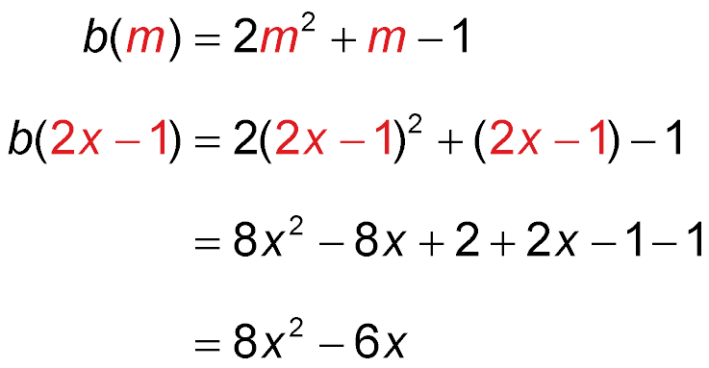
Example 3
Function Values of Variables
Find b(2x – 1) – 3b(x) if b(m) = 2m² + m – 1.
To evaluate b(2x – 1), replace the m in b(m) with
2x – 1.
Original function
Replace m with 2x – 1.
Evaluate 2(2x – 1)².
Simplify.

Slide 15
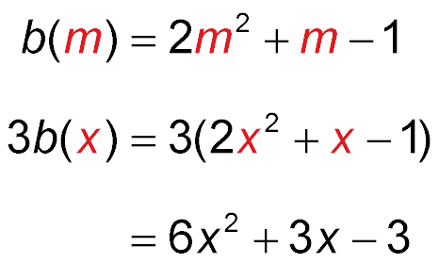
Example 3
Function Values of Variables
To evaluate 3b(x), replace m with x in b(m), then multiply the expression by 3.
Original function
Replace m with x.
Distributive Property

Slide 16
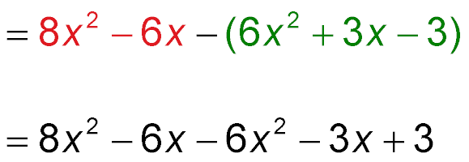
Example 3
Function Values of Variables
Now evaluate b(2x – 1) – 3b(x).
Replace b(2x – 1) and 3b(x) with evaluated expressions.
b(2x – 1) – 3b(x)
Distribute.
= 2x² – 9x + 3 Simplify.
Answer: 2x² – 9x + 3

Slide 17
Example 3
Find g(2x + 1) – 2g(x) if g(b) = b² + 3.
A. 1
B. 2x ² + 4x – 2
C. 2x ² + 4x + 10
D. 2x ² – 2
A
B
C
D

Slide 18
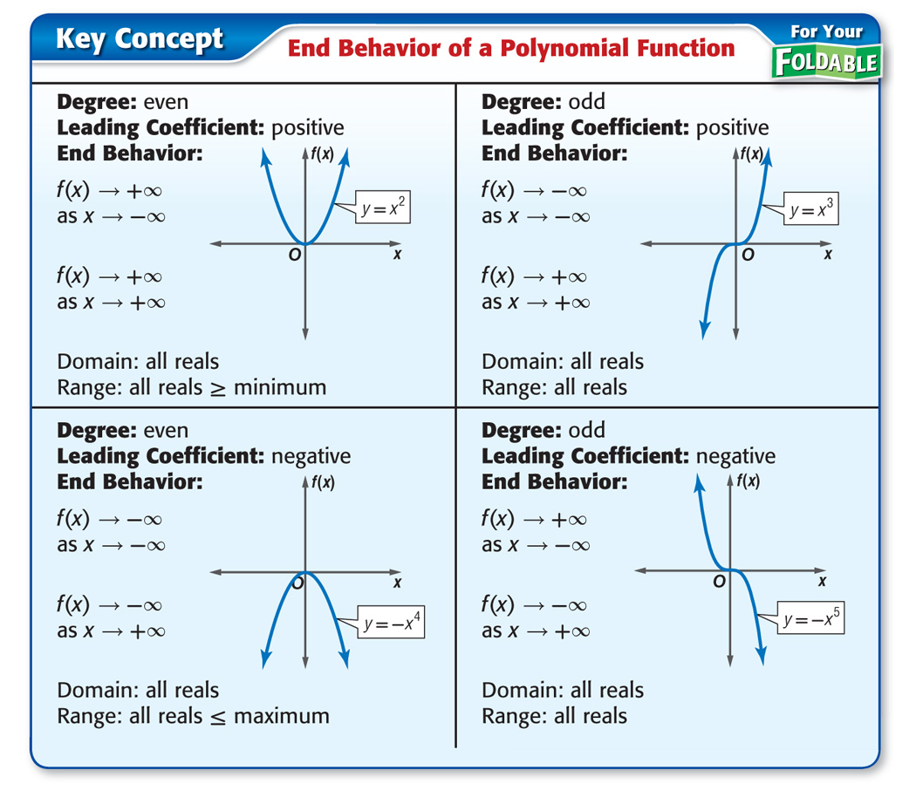

Concept

Slide 19
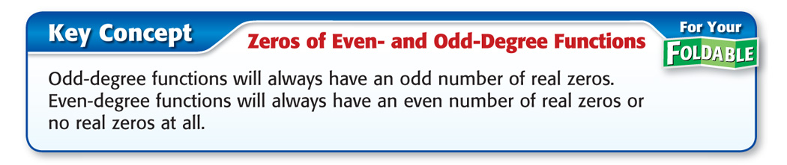
Concept

Slide 20
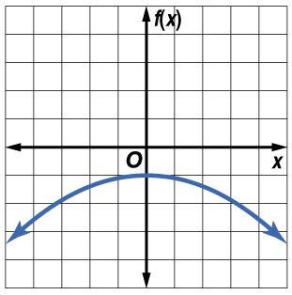
Example 4
Graphs of Polynomial Functions
A. For the graph,
describe the end behavior,
determine whether it represents an odd-degree or an even-
degree function, and
state the number of real zeros.
Answer:
f(x) → –∞ as x → +∞
f(x) → –∞ as x → –∞
It is an even-degree polynomial function.
The graph does not intersect the x-axis, so the function has no real zeros.

Slide 21
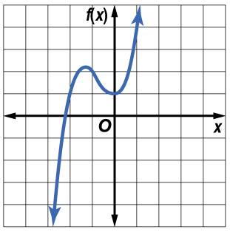
Example 4
Graphs of Polynomial Functions
B. For the graph,
describe the end behavior,
determine whether it represents an odd-degree or an even-degree function, and
state the number of real zeros.
Answer:
f(x) → +∞ as x → +∞
f(x) → –∞ as x → –∞
It is an odd-degree polynomial function.
The graph intersects the x-axis at one point, so the function has one real zero.

Slide 22
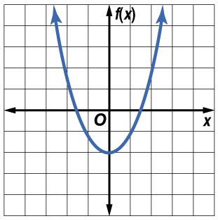
Example 4
A. For the graph, determine whether it represents an odd-degree or an even-degree function, and state the number of real zeros.
A. It is an even-degree polynomial function and has no real zeros.
B. It is an even-degree polynomial function and has two real zeros.
C. It is an odd-degree polynomial function and has two real zeros.
D. It is an odd-degree polynomial function and has no real zeros.
A
B
C
D

Slide 23
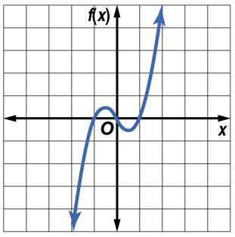
Example 4
B. For the graph, determine whether it represents an odd-degree or an even-degree function, and state the number of real zeros.
A. It is an even-degree polynomial function and has three real zeros.
B. It is an odd-degree polynomial function and has no real zeros.
C. It is an odd-degree polynomial function and has three real zeros.
D. It is an even-degree polynomial function and has no real zeros.
A
B
C
D

Slide 24
End of the Lesson

